Slide 1

AI-Powered Real-Time Log Monitoring and Incident Response System for Web Applications.
Akshay G 211722104011
Akhil TV 211722104012
Godwin Judah J 211722104043
Ruby S
Assistant Professor

Slide 2
Abstract
Modern web applications generate large volumes of log data that are difficult to monitor manually.
Traditional monitoring systems rely on fixed rules and fail to detect unexpected failures.
This project presents an AI-powered real-time log monitoring system.
Uses unsupervised machine learning (Isolation Forest) to detect anomalies.
Implements event correlation and root cause analysis for better incident understanding.
Provides a real-time interactive dashboard with alerts and insights.
Enables faster detection, diagnosis, and response to system failures

Slide 3
Introduction
Modern applications are built using multiple interconnected services.
These systems generate continuous streams of log data.
Logs contain critical information about:
System performance
Errors and failures
User activity
Manual monitoring of logs is:
Time-consuming
Inefficient
Not scalable
Rule-based alerts detect only known issues and miss unexpected anomalies.

Slide 4
Problem Statement
Traditional log monitoring systems are rule-based and static
They rely on predefined thresholds and patterns.
Key Issues
Cannot detect unknown or complex anomalies.
Generate too many alerts (alert fatigue).
No understanding of cross-service failures.
Lack of root cause identification.
Impact
Increased system downtime
Delayed incident response
Reduced system reliability

Slide 5
Objectives of the System
Objectives
Develop a real-time log monitoring system.
Detect anomalies using unsupervised machine learning.
Implement event correlation to group related anomalies.
Perform root cause analysis to identify failure sources.
Generate alerts with severity levels.
System Goals
Provide an interactive dashboard for monitoring.
Enable faster incident detection and response.
Build a scalable and modular system architecture.
Improve overall system reliability and performance.

Slide 6
Proposed System Overview
Proposed System
An AI-powered real-time monitoring system for web applications.
Continuously processes streaming log data.
Uses machine learning to detect abnormal system behavior.
Key Components
Log Generation / Data Ingestion
Data Preprocessing & Feature Engineering
Anomaly Detection (Isolation Forest)
Event Correlation
Root Cause Analysis
Alerting System
Interactive Dashboard
Core Idea
Convert raw logs → meaningful insights
Detect issues → group them → identify root cause → visualize results

Slide 7
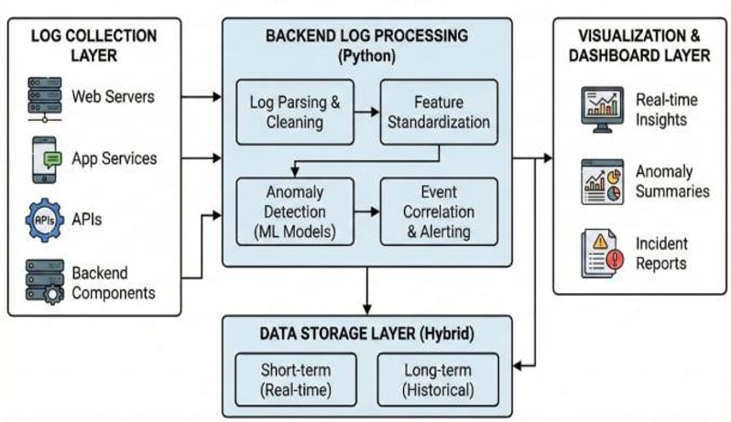
System Architecture Diagram

Slide 8
System Workflow
Content
Log Generation
Continuous logs generated from multiple services
Data Preprocessing
Cleaning and normalization of log data
Feature Engineering
Extraction of meaningful features
Anomaly Detection
Identify abnormal behavior using Isolation Forest
Event Correlation
Group related anomalies into incidents
Root Cause Analysis
Identify the most probable source of failure
Alert Generation
Assign severity and notify
Visualization
Display results on real-time dashboard

Slide 9
Log Generation & Data Ingestion
System simulates real-time log data from multiple services:
Database
API Services
Authentication Service
Log Attributes
Timestamp
Service Name
Log Level (INFO / WARN / ERROR)
Response Time
Anomaly Simulation
Latency spikes
Service failures
Cascading issues across services

Slide 10
Data Processing & Feature Engineering
Data Processing
Cleaning and normalization of log data
Handling missing and invalid values
Standardizing timestamps and log levels
Feature Engineering
Extract key features
Response Time
Error Flag
Warning Flag
Generate advanced features
Rolling Mean & Standard Deviation
Response Time Difference
Interaction Features
Purpose
Convert raw logs into machine learning-ready data
Capture system behavior more effectively

Slide 11
Anomaly Detection Model
Model Used
Isolation Forest (Unsupervised ML Algorithm)
Key Points
Detects anomalies without labeled data
Identifies data points that behave differently from normal patterns
Efficient for real-time and large datasets
Working Concept
Normal data → harder to isolate
Anomalies → easier to isolate
Faster isolation = anomaly
Output
Anomaly Score
Classification
Normal
Anomaly

Slide 12
Event Correlation & Root Cause Analysis
Event Correlation
Groups related anomalies into single incidents
Uses time-window based grouping
Identifies multi-service failures
Root Cause Analysis (RCA)
Analyzes anomalies across services
Identifies the most affected service
Considers:
Response time
Error rate
Anomaly frequency
Output
Correlated incident
Affected services
Root cause service

Slide 13
Alerting & Severity System
Alert Generation
Alerts generated for detected anomalies
Includes
Timestamp
Service Name
Response Time
Severity Levels
Low → Minor issues
Medium → Performance degradation
High → Critical failures
Classification Based On
Response time
Error presence
Frequency of anomalies
Key Feature
Correlated incidents → single alert instead of multiple alert

Slide 14
Dashboard & UI Features
Key Features
Real-time monitoring of logs and anomalies
Interactive charts and visualizations
Anomaly trends and heatmaps
Alert display with severity indicators
Filtering by services
Dashboard Components
System Metrics (logs, anomalies, throughput)
Trend Graphs
Heatmaps
Clustering & Analytics
AI Insights
User Experience
Clean and intuitive interface
Tab-based navigation
Fast and responsive updates

Slide 15
UI Images

Slide 23
Results & Observations
Key Observations
System successfully detects real-time anomalies
Identifies latency spikes and service failures
Event correlation reduces multiple alerts into single incidents
Root cause analysis identifies likely failure source
Performance Insights
Efficient processing of continuous log streams
Low latency in anomaly detection
Stable performance under simulated load
Visualization Outcomes
Clear anomaly trends over time
Easy identification of affected services
Improved system understanding through dashboard

Slide 24
Advantages of the System
Key Advantages
Real-Time Monitoring
Detects system issues instantly
Unsupervised ML Approach
No need for labeled data
Event Correlation
Reduces alert noise
Root Cause Analysis
Faster issue identification
System Benefits
Scalable and modular architecture
Interactive and user-friendly dashboard
Cost-effective (open-source implementation)
Improves system reliability and response time

Slide 25
Applications / Use Cases
Where This System Can Be Used
Web Application Monitoring
Track performance and detect failures in real time
Cloud Infrastructure Monitoring
Monitor distributed systems and microservices
DevOps & Site Reliability Engineering (SRE)
Improve incident detection and response
E-commerce Platforms
Detect service failures affecting transactions
Additional Use Cases
Banking and financial systems
IT operations and server monitoring
Large-scale enterprise applications

Slide 26
Conclusion
Developed an AI-powered real-time log monitoring system
Successfully implemented anomaly detection using Isolation Forest
Incorporated event correlation and root cause analysis
Built an interactive dashboard for visualization and monitoring
Key Outcome
Improved system visibility
Faster detection and response to failures
Better understanding of system behavior
Final Note
Provides a scalable and practical solution for modern system monitoring

Slide 27
Future Scope
Integration with real-world log sources (APIs, servers, cloud systems)
Use of advanced ML / deep learning models for improved accuracy
Implementation of predictive analytics for early failure detection
Integration with alerting systems (email, SMS, dashboards)
Scalability Improvements
Support for large-scale distributed systems
Integration with databases (MongoDB, PostgreSQL)
Deployment in cloud environments

Slide 28
References
[1] X. Zhao, Z. Jiang and J. Ma, "A Survey of Deep Anomaly Detection for System Logs," 2022 International Joint Conference on Neural Networks (IJCNN), Padua, Italy, 2022, pp. 1-8, doi: 10.1109/IJCNN55064.2022.9892726. https://ieeexplore.ieee.org/document/9892726
[2] M. Landauer, S. Onder, F. Skopik and M. Wurzenberger, “Deep learning for anomaly detection in log data: A survey,” Machine Learning with Applications, vol. 12, p. 100470, 2023, doi:10.1016/j.mlwa.2023.100470. https://www.sciencedirect.com/science/article/pii/S2666827023000233
[3] S. Ramachandran, R. Agrahari, P. Mudgal, H. Bhilwaria, G. Long and A. Kumar, “Automated Log Classification Using Deep Learning,” Procedia Computer Science, vol. 218, pp. 1722–1732, 2023, doi: 10.1016/j.procs.2023.01.150. https://www.sciencedirect.com/science/article/pii/S1877050923001503
[4] L. Wang, C. Zhang, R. Ding, Y. Xu, Q. Chen, W. Zou, Q. Chen, M. Zhang, X. Gao, H. Fan, S. Rajmohan, Q. Lin and D. Zhang, “Root Cause Analysis for Microservice Systems via Hierarchical Reinforcement Learning from Human Feedback,” in Proc. of the ACM International Conference, 2023, doi: 10.1145/3580305.3599934. https://doi.org/10.1145/3580305.3599934
[5] T. Jia, Y. Wu, C. Hou and Y. Li, "LogFlash: Real-time Streaming Anomaly Detection and Diagnosis from System Logs for Large-scale Software Systems," 2021 IEEE 32nd International Symposium on Software Reliability Engineering (ISSRE), Wuhan, China, 2021, pp. 80-90, doi: 10.1109/ISSRE52982.2021.00021. https://ieeexplore.ieee.org/document/9700306 66
[6] A. Horváth et al., "Anomaly Detection Algorithms for Real-Time Log Data Analysis at Scale," in IEEE Access, vol. 13, pp. 136288-136311, 2025 10.1109/ACCESS.2025.3594469. https://ieeexplore.ieee.org/document/11105402
[7] LogPAI, “LogHub: A comprehensive log dataset collection,” GitHub repository, 2019. [Online]. Available: https://github.com/logpai/loghub. Accessed: Dec. 28, 2025.
[8] Z. Jiang, J. Liu, J. Huang, Y. Li, Y. Huo, J. Gu, Z. Chen, J. Zhu and M. R. Lyu, “A Large-scale Evaluation for Log Parsing Techniques: How Far are We?,” in Proc. of the ACM SIGSOFT International Symposium on Software Testing and Analysis (ISSTA), 2024. https://arxiv.org/abs/2308.10828
[9] J. Zhu, S. He, P. He, J. Liu and M. R. Lyu, “LogHub: A Large Collection of System Log Datasets for AI-driven Log Analytics,” in Proc. of the IEEE International Symposium on Software Reliability Engineering (ISSRE), 2023. https://arxiv.org/abs/2008.06448

Slide 29
Thank You

